Slide 1

Predicting Customer Churn Using Artificial Neural Network
K.LAKSHMI LASYA
180030291
SEC-03

Slide 2
Introduction
Churn is defined as movement of customer from one company to another.
The reasons can be:
1.Availability of latest technology
2.Customer-friendly staff
3.Low interest rates
4.Location
5.Services offered
Churn rate usually lies in the range from 10% up to 30%.

Slide 3
Problem Description
Telecom companies face major challenge with customer churn, as customers switch to alternate provider due to various reasons like lower cost, multi (combo) service offerings, marketing promotions by competitors, etc.
In the USA, there are 7 telecom companies that serve customers in all 50 states. 13 regional companies serve 29 plus states and thousands of local companies provide internet and TV broadcasting services#.
Identifying these potential customers early on who may voluntarily churn and providing them retention incentives in form of discounts & combo offers will help the organization to retain those customers and reduce revenue loss.
The company can also internally study any possible operational causes and improve its product offerings.
Proactive actions will prevent the loss of revenue for the company and will improve / retain the market share among the industry peers in terms of the number of active subscribers.

Slide 4
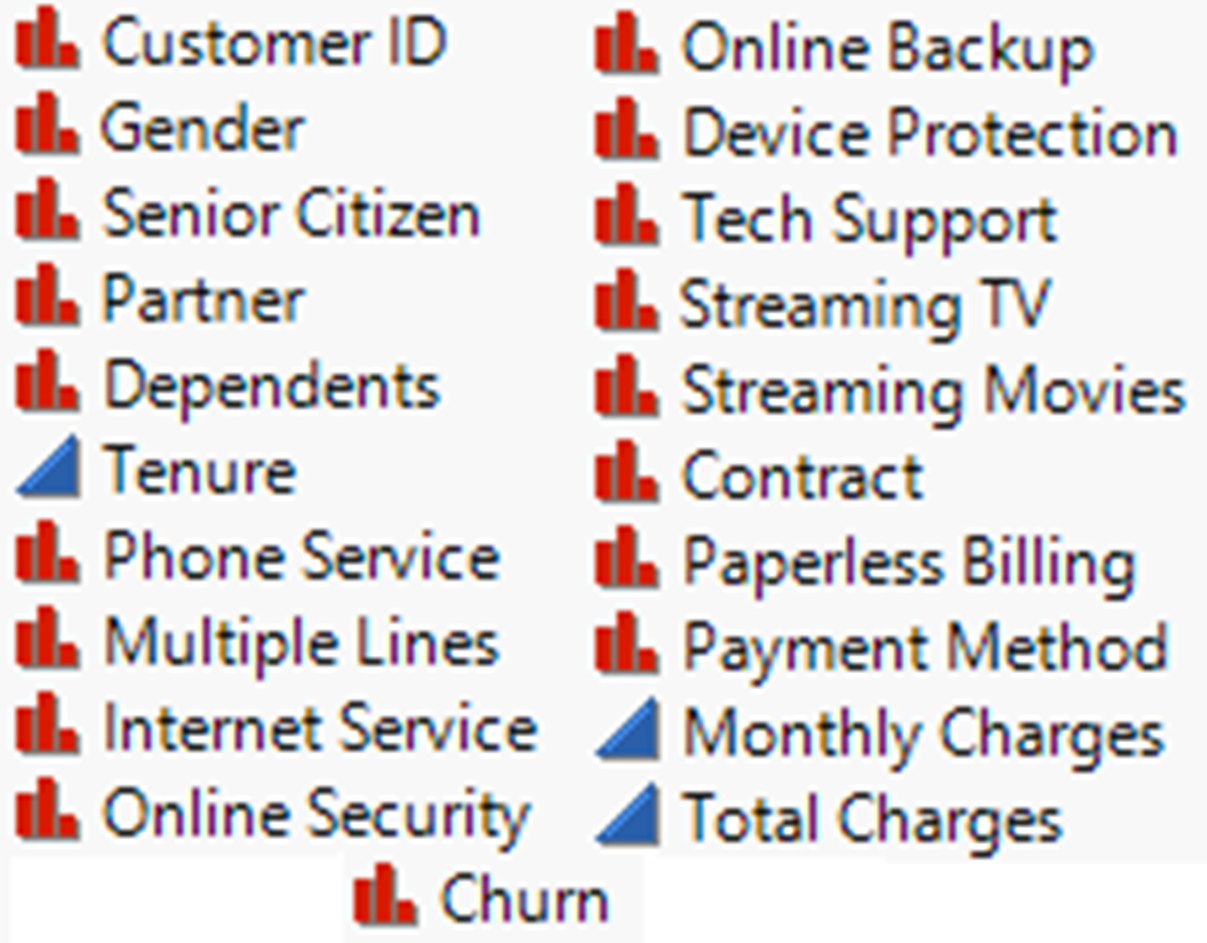
Data Description
Data consists of 7043 fictional customers who belong to various demographics (single; with dependents; senior citizen) and subscribe to different products offerings (internet service; phone line; streaming TV; streaming movies; online security) from a telecom company located in one of the US states.
Independent variables: 17 Categorical and 3 Continuous
Dependent Target variable: “Churn”
Churn Rate (Baseline) is 26.5%
Dataset source: www.kaggle.com/blastchar/telco-customer-churn

Slide 5
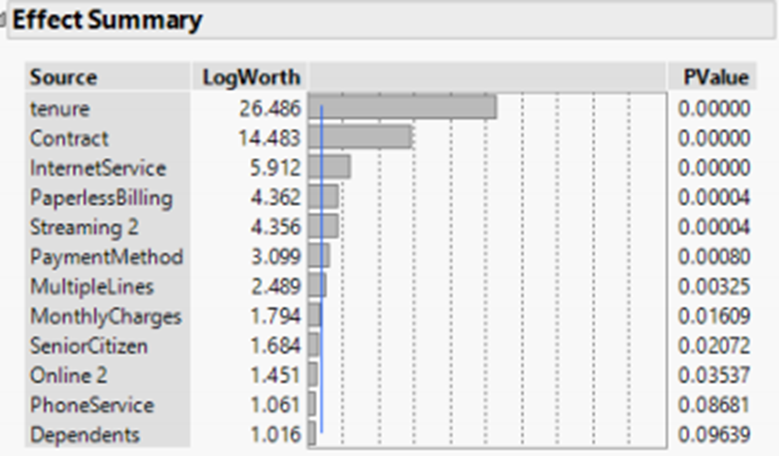
Steps
Data Exploration
Data Modification
Data Reduction
Significant Variables

Slide 6
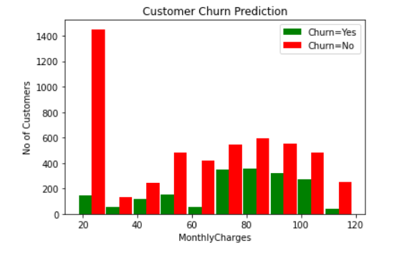
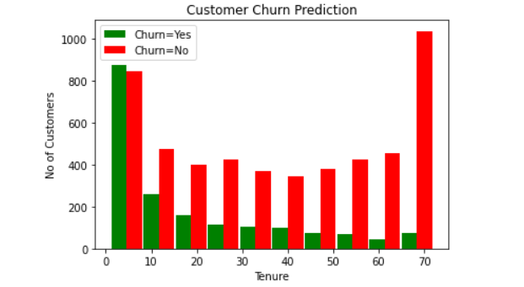
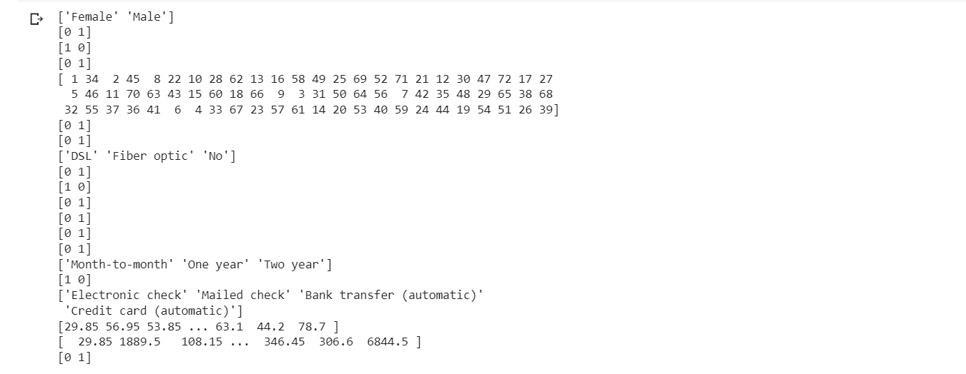
OutPuts

Slide 7
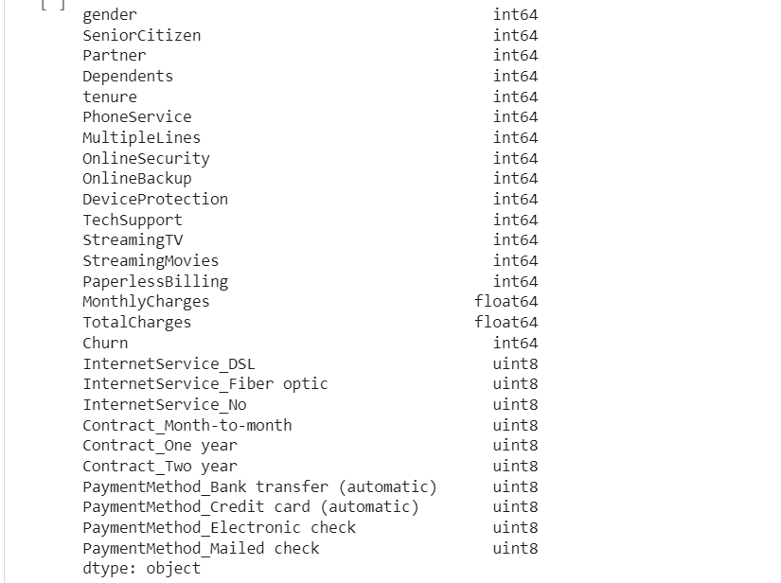
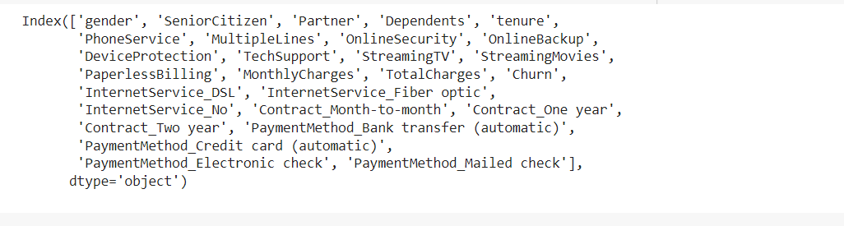

Slide 8
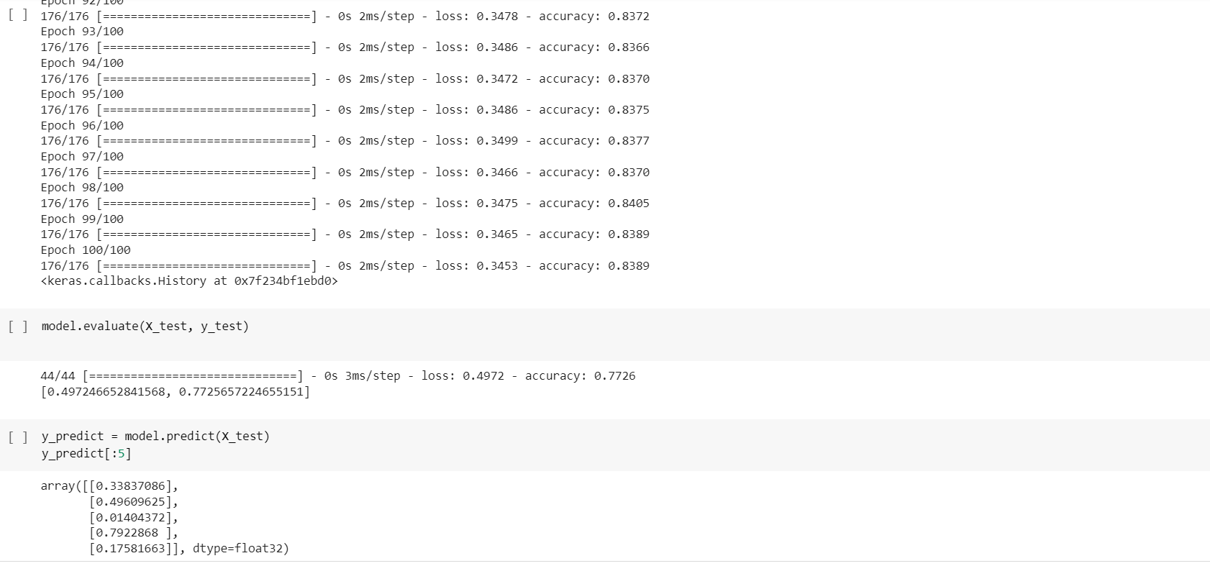

Slide 9
